Slide 1
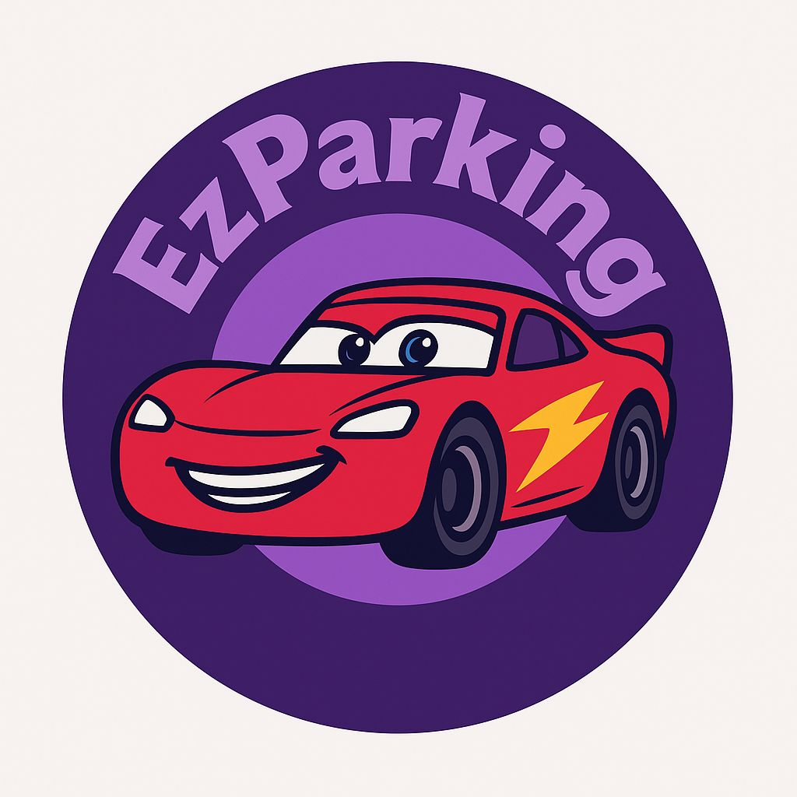
EzParking
Matteo Ventali 1985026
Valerio Spagnoli 1973484
Serena Ragaglia 1941007
Pierluca Grasso 1950186
Federico De Lullo 1935510

Slide 2

Initial Idea
The objective of this project is to create a distributed parking sharing application that enables users to find and share parking spaces in urban areas with minimal reliance on centralized servers. The system fosters a community-driven approach to solving the challenge of:
finding available parking,
reducing traffic congestion and environmental impact,
promoting collaboration among users.

Slide 3
User Stories & Mockups

Slide 4
Account Managment

Slide 5
Resident Functionalities

Slide 6
Parking Search and Driver’s functionalities

Slide 7
Booking and Payment Systems

Slide 8
Notification System

Slide 9
Reputation and Rating Systems

Slide 10
Admin Functionalities

Slide 11
Software estimation

Slide 12
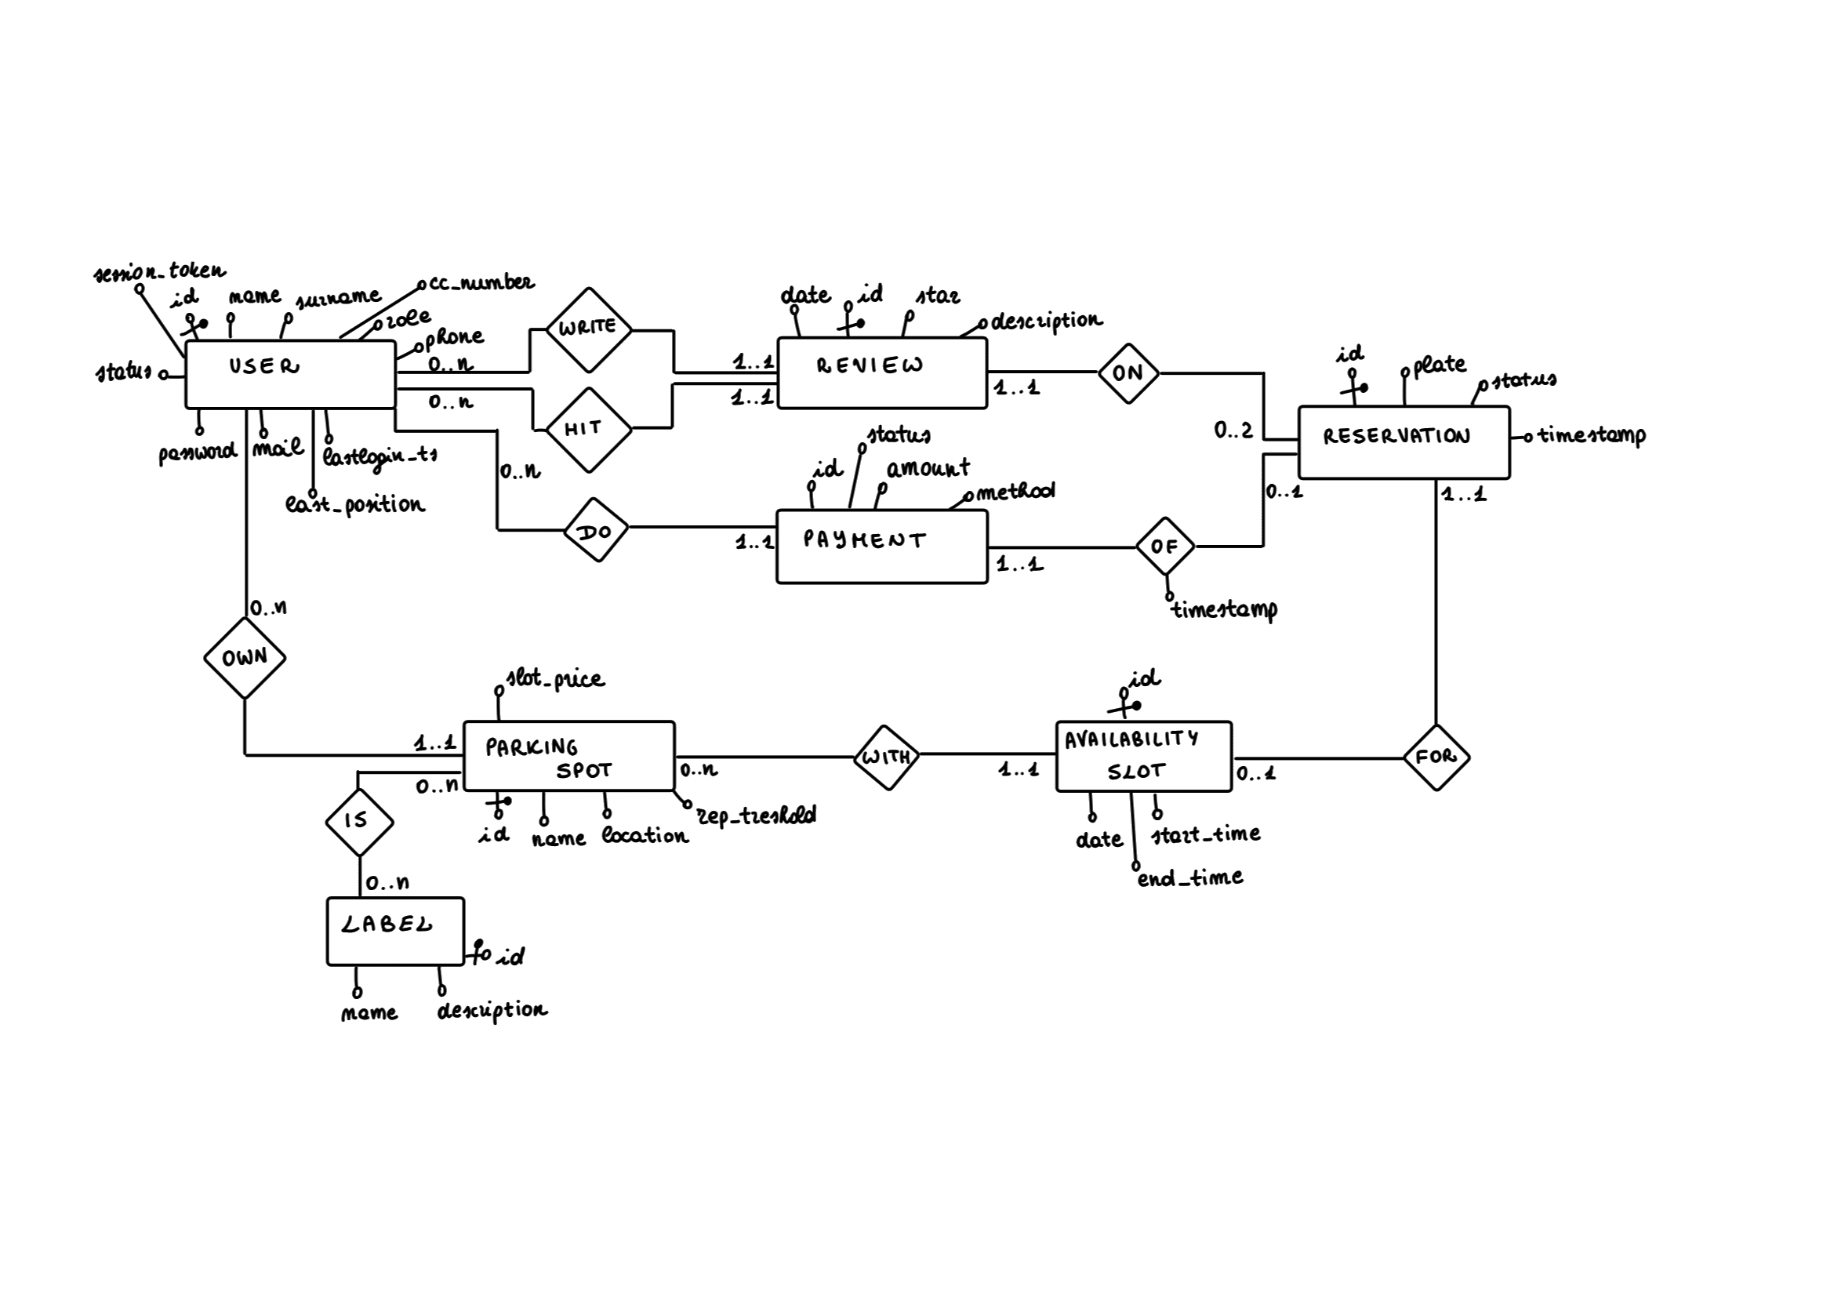
Sketch Diagram

Slide 13
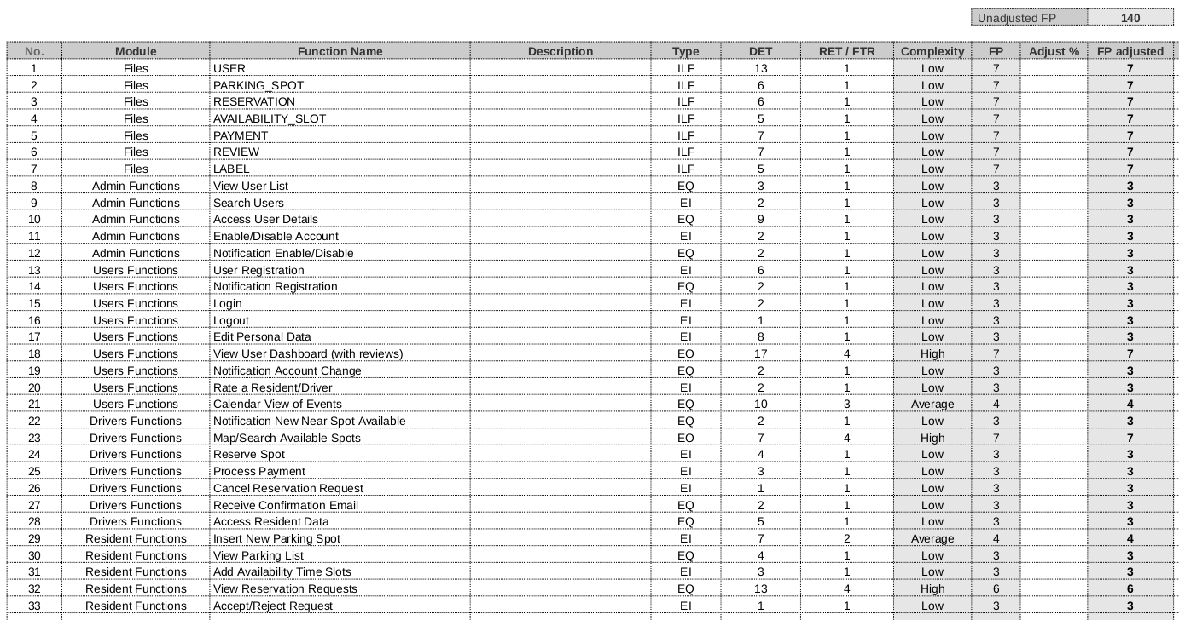
Function Points
7 ILFs
26 Main Functions
140 UFP

Slide 14
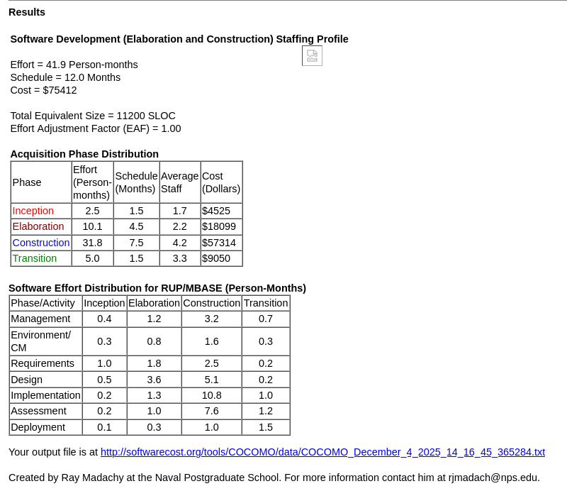
COCOMO II
Early-Model
Scale-Driver set to Nominal
140 UFP = 12 Months of work
Why have we been so fast?
AI help
Unexpected strong cohesion
...

Slide 15
System
Architecture

Slide 16
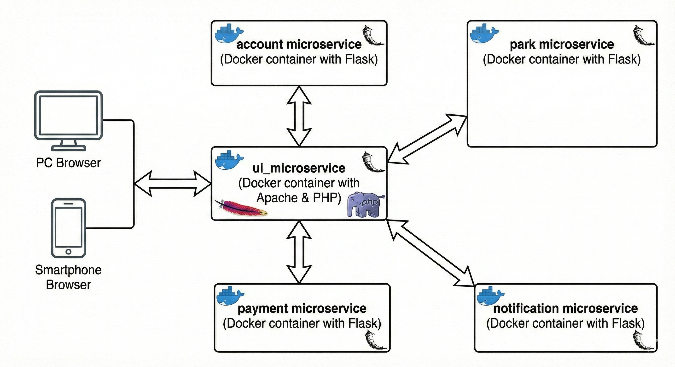
Infrastracture Diagram

Slide 17


Technologies and framework
Architecture & Orchestration:
Microservices-based architecture.
Component orchestration via Docker Compose.
Database & Persistence:
Ensures data persistence for Docker containers.
Stores databases for all microservices components.

Slide 18


Technologies and framework
REST microservices:
implements RESTful interfaces easily.
handles HTTP requests/responses for microservices.
Database access:
facilitates database access for Python microservices.
maps Python objects to database tables efficiently.

Slide 19


External Services
Maps and Geolocalization:
Localization of users and parking spots based on GPS coordinates.
Conversion coordinates-address.
Mail service:
Send notification to users for various events.

Slide 20
Sprints

Slide 21
Demo

